Slide 1
ChatGPT VS Google Search Engine
June-13-2024

Slide 2
Agenda
Introduction
Interaction Style
Information Source
Updates and Knowledge
Personalization
Content Delivery
Summary

Slide 3
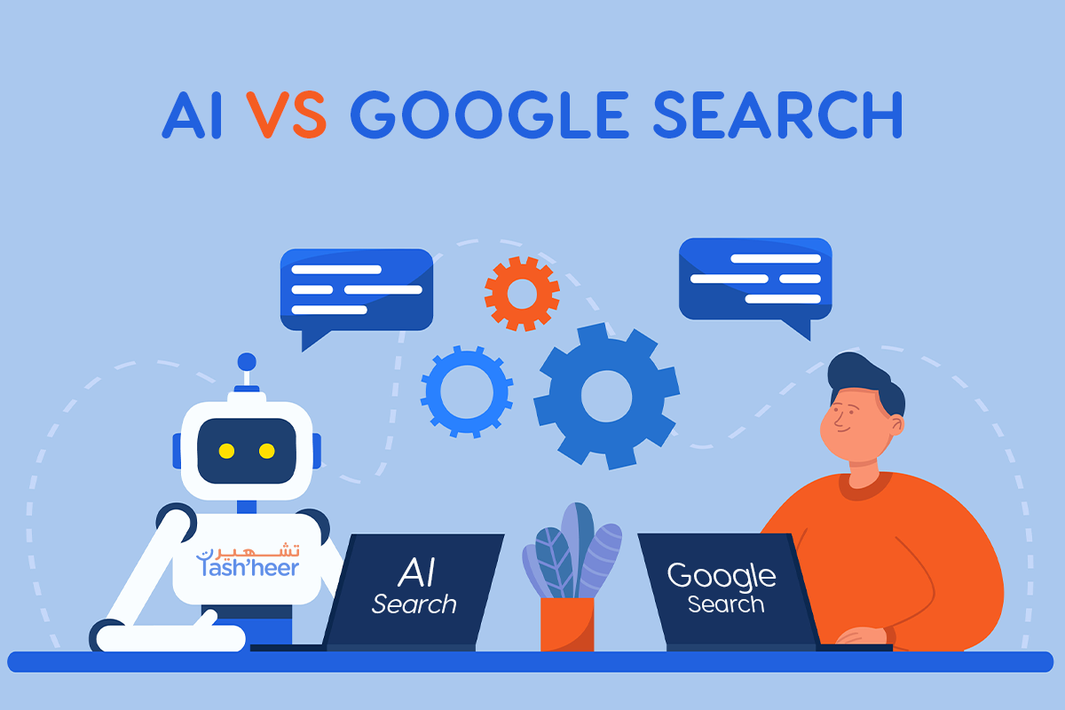
Introduction
Both of these tools are incredibly powerful and serve unique purposes in the information retrieval and interaction.
ChatGPT developed by OpenAI, is an AI conversational agent designed to simulate human-like conversations, providing detailed and context-aware responses.
Search Engine is a comprehensive tool designed to retrieve information from the web, giving users access to relevant web pages.

Slide 4
Interaction Style
ChatGPT:
Direct answers and explanations
Conversational manner
Users can ask follow-up questions
Google Search Engine:
List of search results (links to web pages)
Users click on links for detailed information
Information Source
ChatGPT:
Generates responses based on a vast dataset of text
No real-time access to the internet
Google Search Engine:
Retrieves information from the internet in real-time
Indexes billions of web pages

Slide 5
Updates and Knowledge
ChatGPT:
Knowledge is static
Based on data up to a certain point
No real-time information access
Google Search Engine:
Continuously updates its index
Provides the latest information available on the internet
Personalization
ChatGPT:
Provides personalized responses based on conversation context
Does not track or store personal data across sessions
Google Search Engine:
Provides personalized search results based on search history, location, etc.
Tracks personal data if the user is logged in

Slide 6
Content Delivery
ChatGPT:
Delivers content as text responses within the conversation
Quality and depth of responses vary by query complexity
Google Search Engine:
Delivers content as a list of links to web pages, images, videos, etc.
Users navigate to links for detailed content
Summary
ChatGPT:
Best for conversational interactions and context-aware responses
Google Search Engine:
Excels at quickly finding and providing access to a wide range of up-to-date information

